Slide 1

Leadership Theories
Ms. Sandali Ehalapitiya| AssistantLecturer | SLIIT Business School

Slide 2

Learning Outcomes
At the end of this lesson students should be able to;
Identify major leadership theories.
Explain the trait theory of leadership.
Explain the behavioural theory of leadership.
Explain the contingency theory of leadership.

Slide 3

Contents
Leadership Theories
Trait Theory
Behavioural Theory
Contingency Theory

Slide 4

Leadership Theories
Leadership theories are frameworks that explain how and why certain individuals become effective leaders.
These theories provide insights into different aspects that contribute to successful leadership.
Trait Theory of Leadership
Behavioral Theory of Leadership
Contingency Theory of Leadership

Slide 5

T01: Trait Theory of Leadership

Slide 6
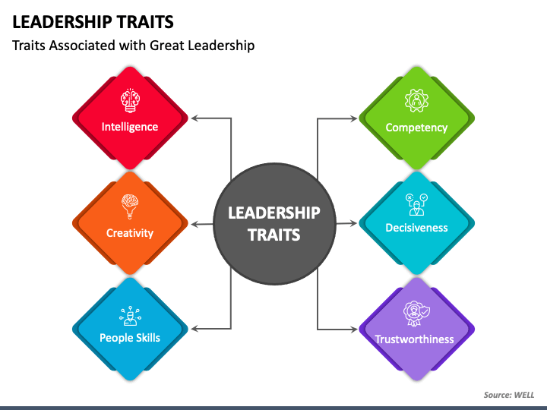
Trait Theory of Leadership
The Trait Theory of Leadership states that effective leaders possess a set of innate traits that distinguish them from non-leaders.
These traits are believed to be inherent qualities or characteristics that naturally lead individuals to leadership roles.
Accordingly, this theory suggests that leaders are distinguishably identified from non-leaders based on the unique characteristics they denote
Notes:
Innate traits are characteristics or qualities that are believed to be inherent and naturally occurring within an individual.
These traits are often considered to be part of a person's genetic makeup and are typically present from birth or develop naturally over time without the influence of external factors.

Slide 7




Examples of Key Traits
Take Notes
Intelligence:
Leaders often exhibit high levels of intelligence, which enables them to analyze situations, make sound decisions, and solve problems effectively.
Self-confidence:
This trait allows leaders to remain assured in their abilities and decisions, inspiring confidence in their followers.
Determination:
Determined leaders exhibit strong willpower and persistence, driving them to achieve their goals despite obstacles.

Slide 8


Take Notes
Examples of Key Traits
Integrity:
Integrity in leaders ensures they adhere to strong moral and ethical principles, earning the trust and respect of their followers.
Sociability:
Sociable leaders are adept at building relationships and maintaining positive interactions with their team members, fostering a supportive and collaborative environment.

Slide 9
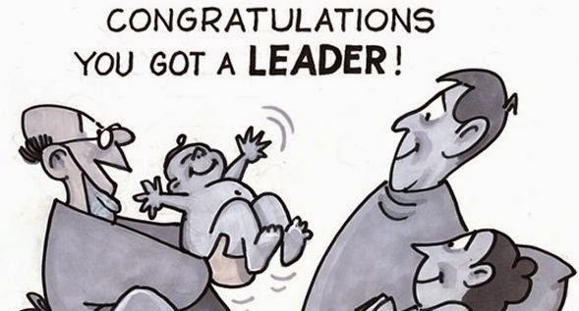
“Leaders are Born”

Slide 10

T02: Behavioral Theory of Leadership

Slide 11
Behavioural Theory of Leadership
The Behavioral Theory of Leadership focuses on the actions and behaviors of leaders rather than their inherent traits.
It states that effective leadership can be learned and developed through the adoption of certain behaviors.
Accordingly, this theory proposes that specific behaviors shown by individuals differentiate themselves as effective/ineffective leaders.
Notes:
Innate traits are characteristics or qualities that are believed to be inherent and naturally occurring within an individual.
These traits are often considered to be part of a person's genetic makeup and are typically present from birth or develop naturally over time without the influence of external factors.

Slide 12
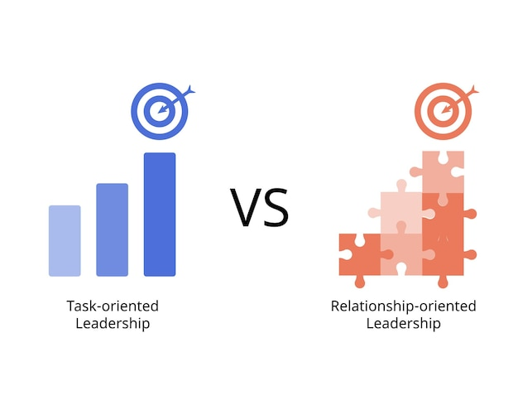
Key Behaviours Explained
Task-oriented Behaviors
Actions aimed at accomplishing tasks and achieving goals.
People-oriented Behaviors:
Actions aimed at building relationships and supporting team members.
Take Notes
Notes:
Task-Oriented
Planning: Setting objectives, developing strategies, and organizing tasks.
Organizing: Allocating resources, assigning roles, and coordinating activities.
Monitoring: Tracking progress, evaluating performance, and making adjustments as needed.
People-Oriented
Supporting: Providing encouragement, resources, and assistance to team members.
Developing: Offering training, mentoring, and opportunities for growth.
Recognizing: Acknowledging and rewarding contributions and achievements.

Slide 13

Studies Supporting the Explanation of the Behavioural Theory

Slide 14

1. The Ohio State Studies
Take Notes
In 1945 a research study was conducted at the Ohio State University, which was based on a questionnaire “Leader Behaviour Description Questionnaire”.
This study revealed two dimensions along which an individual’s leadership behaviour could be studied.
Initiating Structure
Leaders define roles, set goals, and establish clear guidelines.
Consideration
Leaders show concern for the well-being and needs of team members.
Task-Oriented
People-Oriented

Slide 15
2. The University of Michigan Studies
Take Notes
A research study was conducted at the Survey Research Center at the University of Michigan, examining 24 supervisors and 400 workers.
This study also revealed two dimensions along which an individual’s leadership behavior could be studied.
Production-Oriented
Leaders focus on task completion and productivity.
Employee-Oriented
Leaders emphasize interpersonal relationships and employee satisfaction.
Task-Oriented
People-Oriented

Slide 16
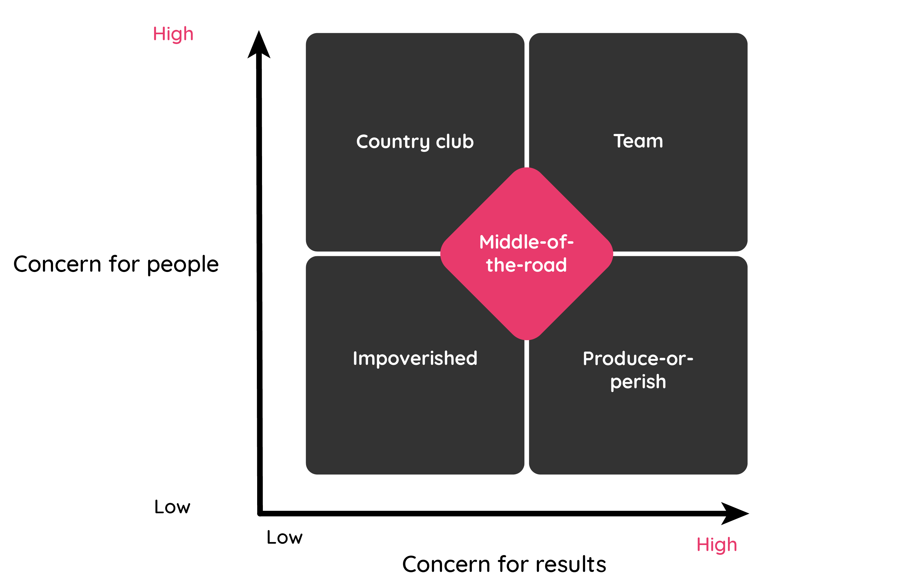
The Blake and Mouton Managerial Grid
Take Notes
Notes:
Leadership Grid
Previously known as the Managerial Grid, the Leadership Grid is based on two behavioral dimensions: concern for production, which is plotted on the X-axis on a scale from one to nine points; and concern for people, which is plotted on a similar scale along the Y-axis.
Blake and Mouton depicted their model as a grid with two axes:
Concern for People
Concern for Production
Note: 'Concern for Production' might be replaced with 'Concern for Task/Results'.
The Blake and Mouton Managerial Grid identified five kinds of leadership behaviour, of which they suggested that the Team Style is the ideal.
Country Club Style
High People - Low Task - Here the leader has a high concern for and usually involvement with people, but a low concern for the task.
There is usually an overly friendly relationship between the leader and the led group.
So although leaders like this appear to care about their people and want to create a comfortable and friendly environment, this style is often not good for creating producing results. People feel good and happy, but the task lacks priority.
Ironically, the group suffers ultimately because they fail to achieve.
The style is common among leaders who are afraid of upsetting people, and/or who fear rejection and being disliked.
Impoverished Style
Low People - LowTask - Here the leader has both a low concern for people and a low concern for the task.
You may ask who would adopt this approach because it is obviously doomed to fail. The answer typically is 'leaders' who care mainly about themselves and are afraid of making mistakes.
Not surprisingly, Blake and Mouton said this is the least effective approach to leadership.
Middle of the Road Style
Mid People - Mid Task - This is essentially an ineffectual compromise. There is some concern for the task and equally, some concern for people, but we might also say there is not enough of either.
Leaders adopting this behavioural approach try to address the needs of the task and their followers to some extent, but do so without conviction, skill or insight and therefore reduce their effectiveness.
Leadership generally requires a good degree of natural authority and decisiveness, so a style which lacks these aspects has much room for improvement.
Produce-or-Perish Style
Low People - High Task - Here we see a high focus on the task with little or no concern for people. This style is often referred to as autocratic.
Leaders using this style seek to control and dominate others.
A leader like this will commonly take the view that staff should be grateful to be employed and paid a salary.
Motivation is often attempted through a threat of punishment, such as being sacked.
This is a dictatorial style. In extreme cases, it would be rightly regarded as ruthless.
Sadly, it can be effective in the short term and interestingly, where a group is failing to react suitably to a serious crisis then it may actually be a viable style for a short period, but the approach is not sustainable, especially where followers have the option to walk away.
This reflects Theory X in Douglas McGregor's X-Y Theory - with the leader often operating under the assumption that individuals are naturally lacking in motivation, and require an external stimulus to inspire productivity.
Team Style
High People - High Task - This style combines a high concern for and involvement in the group with a strong well-organised and communicated focus on achieving the task. Blake and Mouton saw this as the ideal behavioural approach.
Leaders who behave like this manage to blend concern for both people and organisational aims by using a collaborative teamwork approach, and plenty of consultation enabling the development of a shared (not imposed) motivation to achieve the organisation's goals.
This style normally requires that followers/the group are suitably mature and skilled for a high level of involvement. The style is difficult to use and may be inadvisable when leading inexperienced people to produce challenging and vital results in a new or strange area.
This reflects Theory Y in Douglas McGregor's X-Y Theory - with the leader often operating under the assumption that individuals are naturally self-motivated and happy to work so long as they are led well and provided with enough freedom to do so.
Blake and Mouton noted that Team Style was preferable in an ideal world.

Slide 17

“Leaders
can be Made”

Slide 18

T03: Contingency Theory of Leadership

Slide 19

Contingency Theory of Leadership
The Situational Theory of Leadership states that there is no single best way to lead.
Instead, the most effective leadership style depends on the context or situation.
Leaders must adapt their style to fit the circumstances they face.
Notes:
Innate traits are characteristics or qualities that are believed to be inherent and naturally occurring within an individual.
These traits are often considered to be part of a person's genetic makeup and are typically present from birth or develop naturally over time without the influence of external factors.

Slide 20
Key Models related to Situational Theory
Fiedler’s Contingency Model
2. Hersey-Blanchard Situational Leadership Theory

Slide 21



Fiedler’s Contingency Model
This model states that leadership effectiveness depends on the match between a leader's style and the degree to which the situation allows the leader to control and influence.
Situational Factors:
Leader-member relations
Task structure
Position power.
Take Notes
Notes:
Example: A task-oriented leader might be more effective in highly structured situations with clear tasks and strong authority, whereas a relationship-oriented leader might excel in less structured environments with strong leader-member relations.

Slide 22
Leader-Member Relations
This factor refers to the degree of trust, respect, and confidence that exists between the leader and their followers.
Good Relations:
When the relationship is positive, the leader has a greater influence over the group.
Poor Relations:
When the relationship is strained, the leader's influence is weakened.
Situation is Favourable
For example, in a team where members trust and respect their leader, the leader can effectively guide and motivate them.
Situation is Unfavourable
For example, if team members distrust their leader, it becomes challenging for the leader to get their buy-in on decisions.
Take Notes

Slide 23
Task-Structure
This factor refers to the clarity and specificity of the task at hand, including how well-defined the task goals, processes, and procedures are.
High Structure:
Tasks that are clearly defined with specific procedures and clear outcomes.
In such situations, it is easier for a leader to guide and control the process.
Low Structure:
Tasks that are ambiguous or lack clear guidelines.
It might be harder for the leader to ensure that team members understand what needs to be done and how to do it.
Situation is Favourable
For example, Assembly line work
Situation is Unfavourable
For example, Creative projects
Take Notes

Slide 24
Positional Power
Take Notes
This factor refers to the authority and power the leader has by virtue of their position within the organization, including their ability to reward or punish.
Strong Position Power
When a leader has significant authority to make decisions, allocate resources, and enforce rules.
This enhances the leader's ability to influence followers.
Weak Position Power
When a leader has limited authority and cannot easily reward or punish.
This limits the leader's ability to enforce directives.
Situation is Favourable
For example, A CEO or manager with hiring/firing power
Situation is Unfavourable
For example, A project leader without formal authority

Slide 25


Hersey-Blanchard Situational Leadership Theory
The context referred to in this theory is simply the differences in the nature of followers, that the leaders will have to deal with.
Effective leadership depends on the nature of followers based on;
Their Competence (Able or Unable)
Their Commitment (Willing or Unwilling).

Slide 26
Nature of Followers
Follower: Unable and Unwilling
Follower: Unable but Willing
Follower: Able but Unwilling
Follower: Both Able and Willing

Slide 27
Leadership Behaviour that Fits the Nature of Followers
Follower: Unable and Unwilling
Leader: High Task – High Relationship. (Coaching)
Follower: Unable but Willing
Leader: High Task- Low Relationship. (Directing)
Follower: Able but Unwilling
Leader: Low Task – High Relationship. (Supporting)
Follower: Both Able and Willing
Leader: Low Task- Low Relationship. (Delegating)

Slide 28

Activity

Slide 29
Time for some questions from today’s lesson!
Tell me if the below statements are true or false

Slide 30
Time for some questions from today’s lesson!
Tell me if the below statements are true or false
1. The Trait Theory of Leadership suggests that leaders are made through experience and learning.
2. According to the Behavioral Theory of Leadership, specific behaviors shown by individuals can differentiate leaders from non-leaders.
3. Fiedler’s Contingency Model states that the effectiveness of a leader is solely dependent on their innate traits.

Slide 31
Time for some questions from today’s lesson!
Tell me if the below statements are true or false
4. The Hersey-Blanchard Situational Leadership Theory emphasizes that effective leadership depends on the nature of the followers.
5. The Ohio State Studies identified 'Production-Oriented' and 'Employee-Oriented' as the two dimensions of leadership behavior.
6. The Behavioral Theory of Leadership proposes that leadership can be learned and developed through certain behaviors.

Slide 32
7. The Trait Theory of Leadership suggests that intelligence is not considered an important trait for effective leaders.
8. In the Blake and Mouton Managerial Grid, the 'Team Style' of leadership is considered the least effective approach.
9. Fiedler’s Contingency Model includes situational factors such as leader-member relations, task structure, and position power.
10. The Hersey-Blanchard Situational Leadership Theory categorizes followers based on their competence and commitment.

Slide 33


